Slide 1
KLE TECH HACKFEST 2026 | SCREENING ROUND
GRIDGUARDIAN AI
AI-Powered Energy Monitoring, Fault Prediction & Protection
Team details: Team Spark
[Swati, Nandini, Sukanya, Akshata, Sinchana]
Domain selected :
3A – Intelligent AI-Enabled
Operational Ecosystems
for Energy & Utilities
TARGET USERS:
Energy / utility operators
Maintenance engineers
Industrial facility teams
Problem We Aim to Solve:
Traditional energy systems detect faults after they occur, causing energy wastage, equipment damage, and downtime.
SENSE > ANALYZE > PREDICT > PROTECT

Slide 2
KLE TECH HACKFEST 2026 | SCREENING ROUND
Proposed Solution and objectives:
Idea: Grid Guardian AI continuously collects electrical parameters and uses AI to identify abnormal patterns and predict possible faults.
Core Features
Real-Time Monitoring – Voltage, current, power & energy
AI Fault Prediction – Detect abnormal patterns & predict overloads
Automatic Protection – Relay-based shutdown with alerts
Smart Dashboard – Live data, trends & fault status
Intended Benefits
Early Fault Detection – Identify problems before failure
Reduced Downtime – Faster response to abnormal conditions
Energy Efficiency – Identify unusual energy consumption
Equipment Protection – Prevent damage through automatic shutdown
Better Decision-Making – Simple dashboard with actionable insights

Slide 3
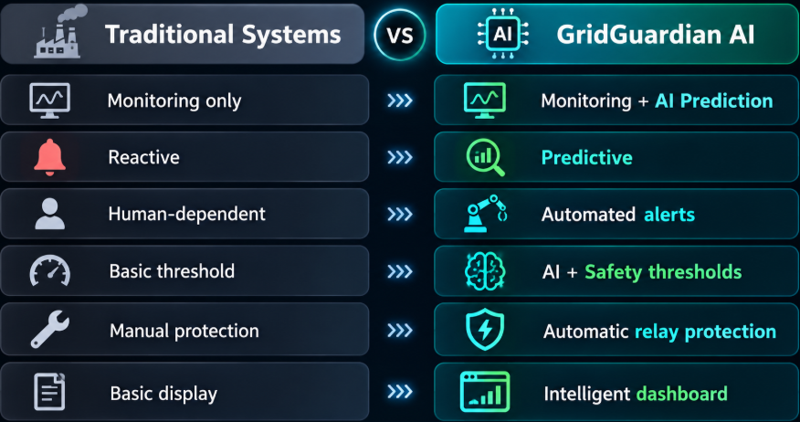
KLE TECH HACKFEST 2026 | SCREENING ROUND
Innovation & Existing Alternatives
Existing Approach
Traditional energy monitoring systems:
Sensor → Meter → Human observes → Action
Limitations
Our Approach
Sensors → Edge Processing → AI Prediction → Alert → Automatic Protection
Human monitoring required
Faults may be detected only after limits are crossed
No intelligent analysis of historical patterns

Slide 4
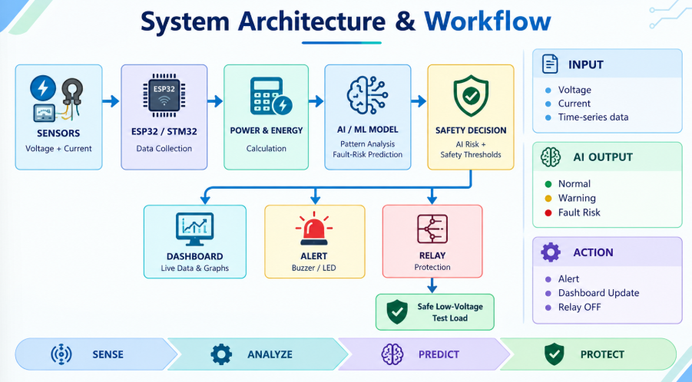
KLE TECH HACKFEST 2026 | SCREENING ROUND

Slide 5
KLE TECH HACKFEST 2026 | SCREENING ROUND
Technology Stack & Implementation Plan
HARDWARE
ESP32
ACS712 Current Sensor
Isolated Voltage Sensor
Relay Module
Buzzer + Green/Red LEDs
Safe Low-Voltage Test Load
SOFTWARE / AI
Arduino IDE + C/C++ – ESP32 programming
Python – Data processing & AI
Scikit-learn – Fault prediction
Stream 3-Day Plan
Day 1: Hardware Setup + Data Collection
Day 2: AI Model + Dashboard
Day 3: Integration + Testing + Demo
Stream lit – Live dashboard
TEAM RESPONSIBILTIES
Member 1: Hardware & Sensors
Member 2: Embedded & Firmware
Member 3: AI/ML & Fault Prediction
Member 4: Dashboard & Software
Member 5: Integration, Testing & Documentation

Slide 6
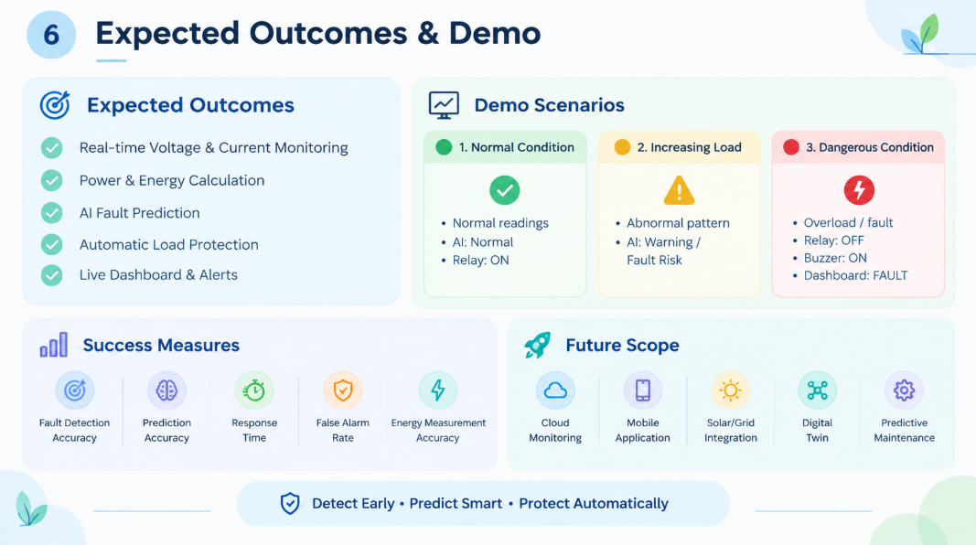
KLE TECH HACKFEST 2026 | SCREENING ROUND

